Slide 1
MNIST Data Classification Via Neural Networks

Slide 2
Types of Neural Networks Used
One layer Feedforward Neural Network (Sigmoid)
Multilayer Feedforward Neural Network (Sigmoid)
Multilayer Feedforward Neural Network (Fast Sigmoid)
Multilayer Feedforward Neural Network (Tanh)
Deep Neural Feedforward Network

Slide 3
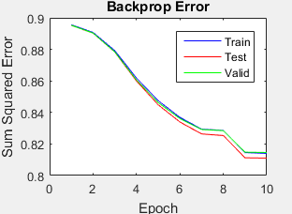
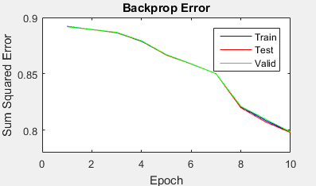
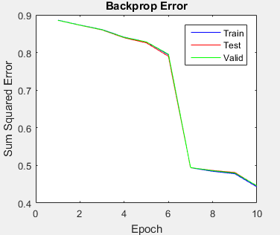
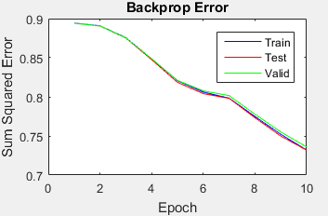
One layer Feedforward Neural Network (Sigmoid)
Input | 784 | 784 | 784 | 784
Layer1 | 80 | 20 | 10 | 5
Output | 10 | 10 | 10 | 10
Epochs | 10 | 10 | 10 | 10
Momentum | 0.1 | 0.1 | 0.1 | 0.1
Learning Rate | 0.1 | 0.1 | 0.1 | 0.1
3
1
2
4

Slide 4
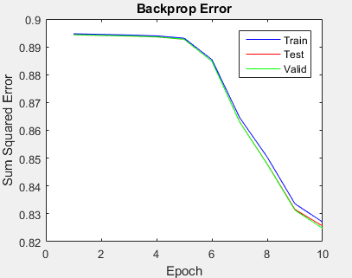
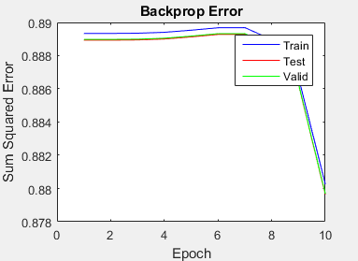
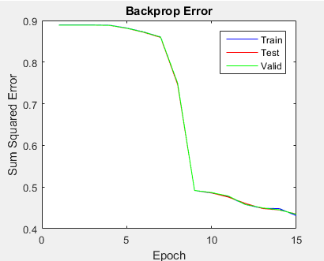
Multilayer Feedforward Neural Network (Sigmoid)
3
1
Input | 784 | 784 | 784
Layer1 | 78 | 30 | 30
Layer2 | 10 | 5 | 5
Output | 10 | 10 | 10
Epochs | 10 | 15 | 10
Momentum | 0.1 | 0.1 | 0.1
Learning Rate | 0.1 | 0.1 | 0.1
2

Slide 5
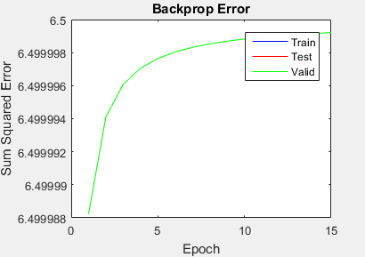
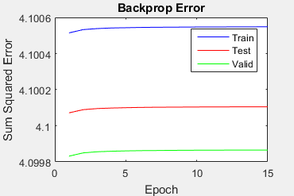
Multilayer Feedforward Neural Network (Fast Sigmoid)
1
Input | 784 | 784
Layer1 | 78 | 30
Layer2 | 30 | 5
Output | 10 | 10
Epochs | 10 | 15
Momentum | 0.1 | 0.1
Learning Rate | 0.1 | 0.1
2

Slide 6
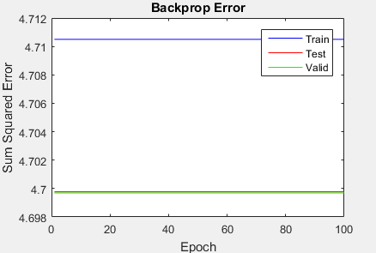
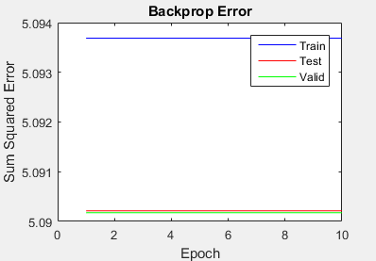
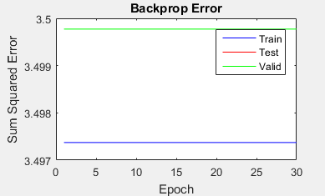
Multilayer Feedforward Neural Network (Tanh)
3
1
Input | 784 | 784 | 784
Layer1 | 5 | 5 | 5
Layer2 | 5 | 5 | 5
Output | 10 | 10 | 10
Epochs | 100 | 30 | 10
Momentum | 0.1 | 0.1 | 0.1
Learning Rate | 0.1 | 0.1 | 0.1
2

Slide 7
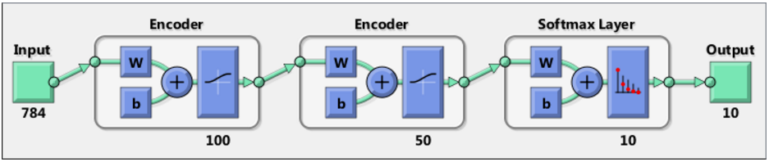
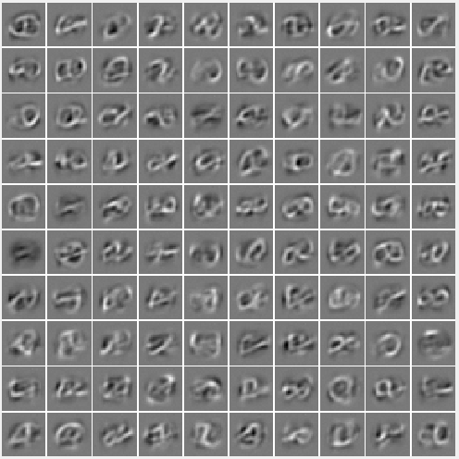
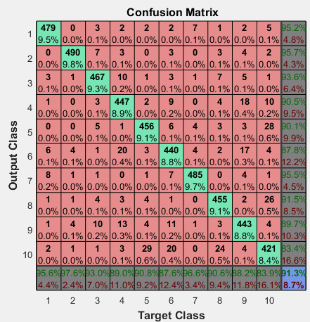
Deep Neural Feedforward Network

Slide 8
Conclusion
Based on observation of sum squared errors, its apparent that the neural network works best with 5 hidden neurons in “One layer feed forward network (sigmoid)” and the classification is best with 30 layer1 neurons and 5 layer 2 neurons in “Multilayer feedforward neural network (sigmoid)”.
Both Fast sigmoid & “Tanh” are no way in comparison
Deep Neural network seems best of all with a 91.3% accuracy.

